Slide 1
Health Economics
Chapter 8: Demand and Supply for Health Insurance

Slide 2
Insurance and Self-Protection
Insurance
Reduction of financial loss due to uncertain event
Self-Protection
Reduction of probability of financial loss occurring

Slide 3
What is Insurance?
Example:
100 individuals
Once a year one of them gets sick and has to pay $2,000
Incidence of illness is random
Club members decide to collect $20 each and put it into a “firm” that manages the money and pays the sick person the $2,000
Reduction of financial losses due to accidental events

Slide 4
How does Insurance Work?
Most health care is paid not directly by individuals, but indirectly through insurance plans.
Insurance coverage is paid by premiums or taxes.
For any one person, health care expenses are uncertain. Some people may never get seriously ill whereas others will. Catastrophic events can ruin a person or a family if insurance were not there.
Imagine a club where the probability of getting ill is the same for everyone. If you do get sick, it costs $10,000 to recover. Since everyone has the chance of getting ill, people pool risk and pay small amounts to cover catastrophic events.
Explains why the federal government helps out in catastrophes.

Slide 5
Ideal Insurance Arrangement
Large number of individuals (large pool)
Individuals are independently exposed to risk (no epidemics, no domino effects,…)
Losses covered should be definite in time, place, and amount
The chance of loss should be measurable
Loss should be accidental (independent of individual behavior)

Slide 6
Social vs. Private Insurance
Social Insurance
Provided by the government and financed in part by taxes
Social security, Medicare and Medicaid
Premiums are heavily subsidized
Participation depends on eligibility rules (age/income)
Private Insurance
Provided in markets by insurance companies
We concentrate on the private market first.

Slide 7
Insurance Terminology
Coinsurance rate: a percentage of the full market price that patients pay for medical services
Copayment: fixed amount paid per prescription or treatment
Deductible: amount above which insurance payments start
Out-of-Pocket Expenses = (1) + (2) +(3) the absolute amount the patient pays for medical services
Premium: price of insurance
Exclusions: services not covered
Limitations: maximum coverage
Pre-Existing Conditions: not covered if condition existed prior to buying insurance

Slide 8
Moral Hazard and Adverse Selection
Moral hazard ↔Hidden Action
More precisely, moral hazard occurs when an insured party takes an unobserved action in response to a contractual arrangement
e.g. less careful driving after signing car insurance,
demand more health care after signing health insurance contract
Adverse Selection ↔Hidden Information
Seller has information about quality of good, but buyer cannot distinguish between high and low quality
e.g. insurance company does not know whether you are a good or bad driver
Buyer of used car does not know the quality of the car

Slide 9
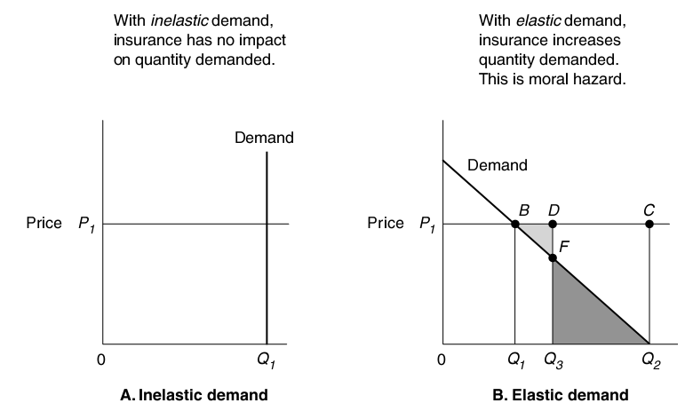
Demand for Care and Moral Hazard

Slide 10
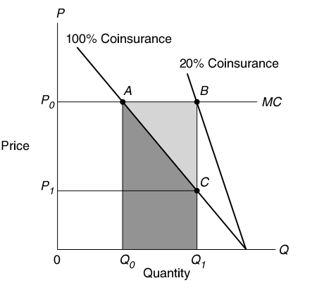
Health Care Demand with Insurance Coinsurance
Marginal benefit reflected in demand curve
The shaded region (ABC) represents the (social) cost of medical care above and beyond the value that the patient places on the service.
i.e., the extra units of service are worth less to the consumer than the price of care the insurer pays on their behalf.
P1=0.20*P0

Slide 11
Effect of Insurance on Health Care Demand: Summary
Market for Health Care
Insurance will increase the demand for health care vs. other goods (distortion)
Insurance will make demand less responsive to the market price (less elastic).
The deadweight loss associated with insurance is decreasing in the coinsurance rate (i.e., decreases as people pay a larger share of the full price).
Market price
No insurance, Coinsurance =100%
Coinsurance of 50%
P
P’
Q₁
Q₁’
Q_{Max}
Q

Slide 12
How Does this Effect Change with Steepness?
Market for Health Care
Market for Health Care
Market price
Market price
Coinsurance of 50%
No insurance
Coinsurance of 50%
No insurance
P
P
P’
P’
Q₁
Q₁’
Q_{Max}
Q₁
Q₁’
Q_{Max}
Q
Q

Slide 13
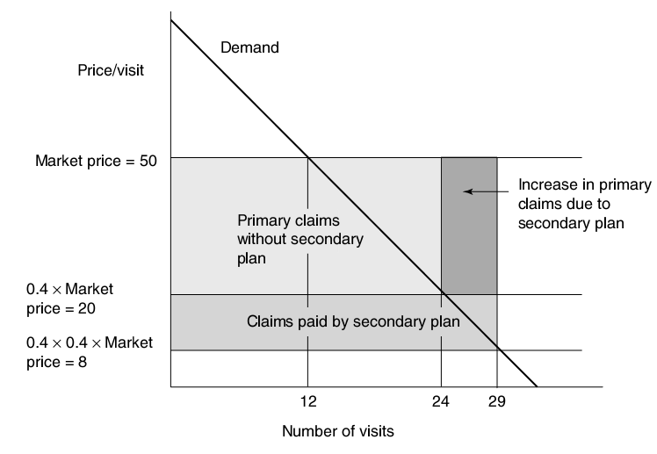
Secondary Insurance
Two insurance companies: the first pays 60% of claim, the second pays 60% of the residual claim.
Moral Hazard is exacerbated, from here to there

Slide 14
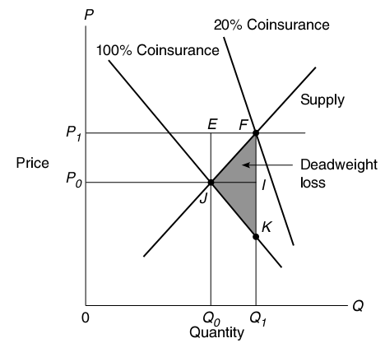
Market Context: Insurance Cost Sharing
Market for Health Care
With elastic supply, insurance:
Increases the market price for medical services
Increases the quantity demanded for medical services

Slide 15
Market for Health Care
The fundamental trade-off: Insurance versus higher medical care prices
Since WWII, the real health expenditures have increased 700%.
Researchers have estimated that 10-50% of the increase is due to the spread of insurance
but also note that high health status decreases demand
10% had private insurance in 1940, nearly 80% by 2000
In addition, income tripled over the period, but still only accounts for roughly an additional 10% of the increased health costs.
40 percent of the increase is caused by other things than income and insurance.

Slide 16
RAND Study
Purpose: To investigate consumer responsiveness to the price of medical care
Time period: 1974-1977
Design: Randomly assign participants to insurance plans with different coinsurance rates
Random assignment avoids people selecting into a plan based on their projected health needs
Those assigned to plans with higher coinsurance rates were given supplementary income to compensate
Coinsurance rates were 0, 25, 50, and 95 percent

Slide 17
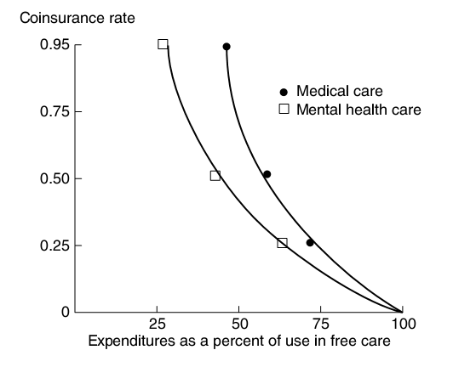
RAND Study (2)

Slide 18
RAND Study - Findings(3)
Ambulatory care: usage sensitive to coinsurance rates across the board
Hospital care: most sensitive going from 0 to 25 percent coinsurance.
Once coinsurance rates are higher, demand is insensitive.
Possibly because care became “catastrophic” and became free care quickly
Medical expenditures: decreased as a function of the coinsurance rate
Income: high income groups less responsive to price
possibly reflecting the fact that time costs are more important for higher incomes (an not the cost of the HC service), or that
the share of a person’s budget spent on medical care decreases as income increases (care is a normal good, not a superior good)

